Slide 1
CMR College of Engineering & Technology
(UGC Autonomous)
Accredited by NAAC with “A” Grade
Kandlakoya, Medchal Road, Hyderabad-501401
Department of CSE- (AI & ML)
COMPARITIVE ANALYSIS OF MAZE USING SEARCHING ALGORITHMS
PRC-2
BATCH NO.33
Team Members:
20H51A6656_abhishek
20H51A6662_P.sai kiran
20H51A6619_vinay
Guided By:
MR.P.SAI KUMAR
Asst professor
CSE(AI&ML) DEPT
CMRCET – CSE (AI& ML)

Slide 2
INTRODUCTION
Artificial Intelligence now a days is growing in every industries and have a huge impact.
Gaming industry have been facing the challenge by the artificial intelligence.
Maze runner game is labyrinth created by the player .
Different kinds of algorithm are there for finding the shortest path .
Maze runner game finding the best path by using the three algorithms and facing the challenges.
This maze runner game is help full for the game creater for finding the best algorithms to implement in the game .

Slide 3
Literature review
Behnam Rahnama, Atilla Elci and Shadi Metani, "An image processing approach to solve Labyrinth Discovery robotics problem", 36th International Conference on Computer Software and Applications Workshops, 2012.
N.Hazim, S.S.M.Al-Dabbagh, and M.A.S.Naser, “Pathfinding in strategy Games and Maze solving Using A* Search Algorithm,” Journal of Computer and Communication, January 2016, pp.15-25
S.J.Russell and P.Norvig, “Artificial Intelligence : A Modern Approach,” Third Edition, Pearson India, pp.64-108, 2018

Slide 4
Proposed Method
Finding the shortest path in a maze in less time and by iterating a minimum number of nodes is a difficult problem. As there are many algorithms used in solving this problem, the performance of algorithms differs accordingly.
So, in this project we have used 3 algorithms and compared the performance between them. The maze finding problem is outlined as finding a path from purpose(place to begin) to the ending point in a very means that the trail therefore found should be the best optimal path

Slide 5
BLOCK DIAGRAM
Generate the maze
Set Goal
Create Obstacles
BFS
DFS
A*
RESULT
Comparision of algorithms

Slide 6
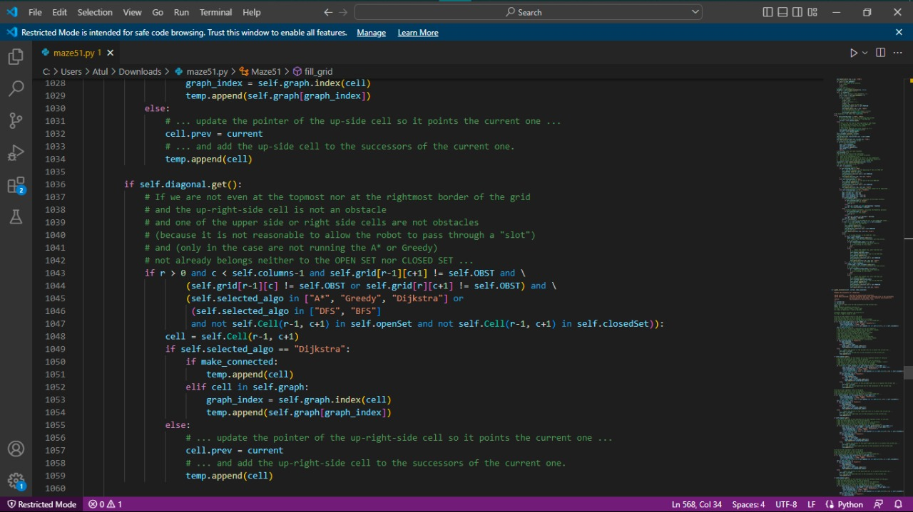
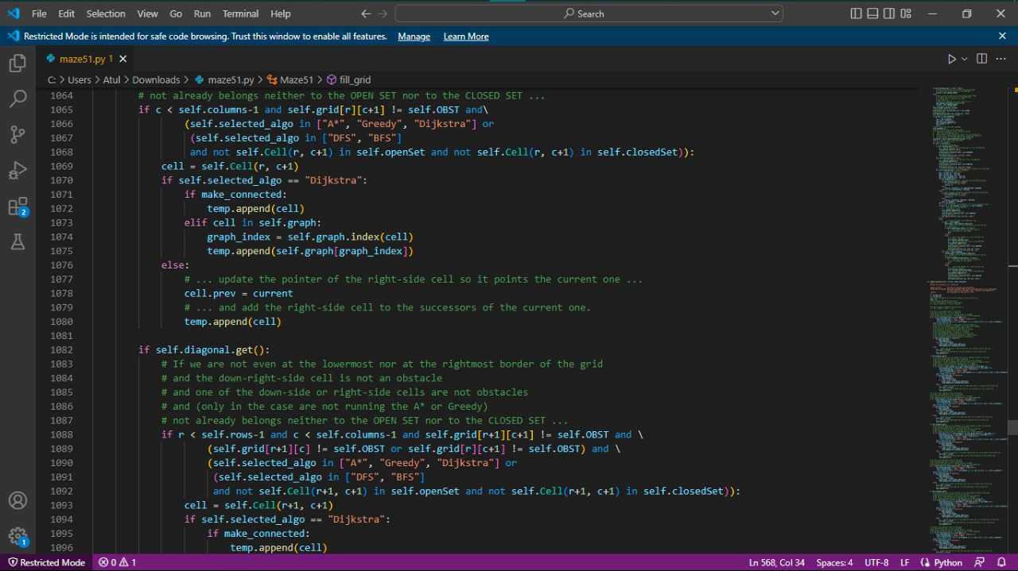
Execution of code

Slide 7
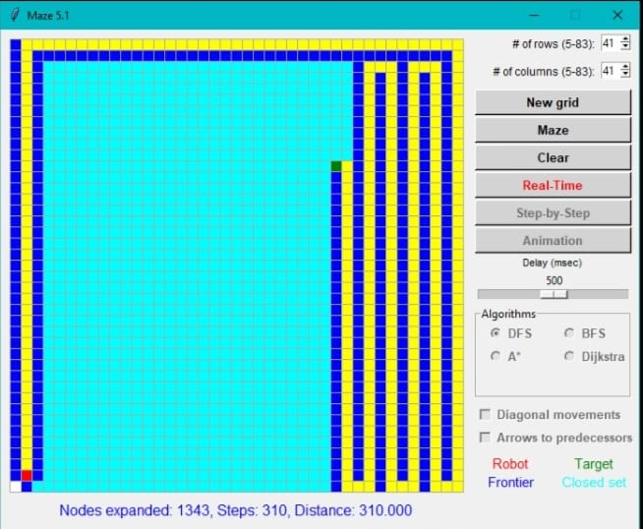
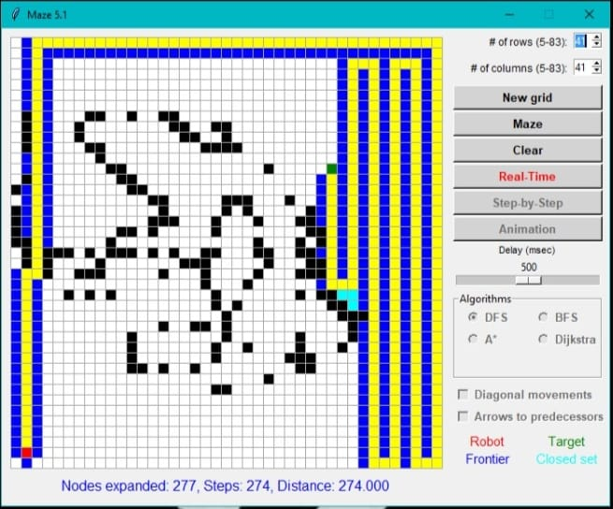
RESULT
DFS with out obstacles
DFS with obstacles

Slide 8
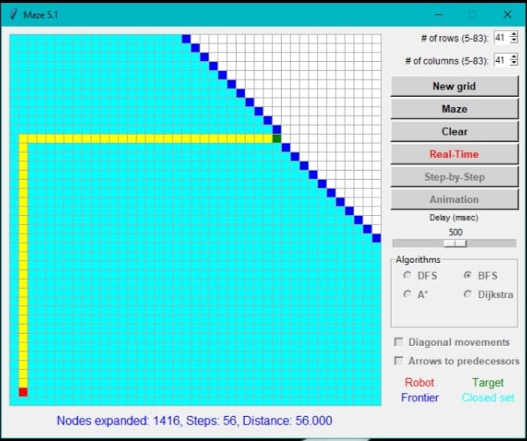
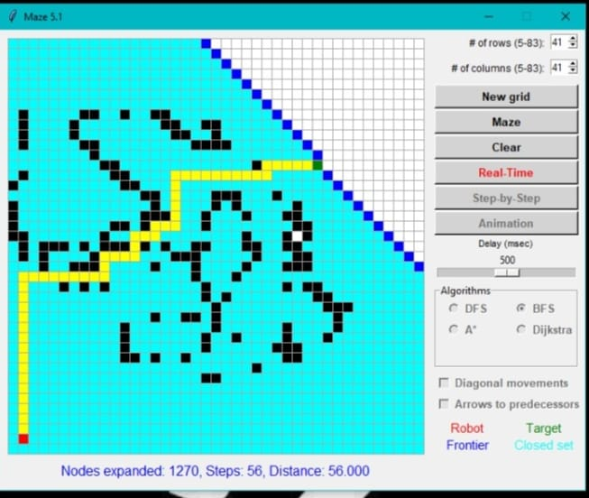
BFS with out obstacle
BFS with obstacle

Slide 9
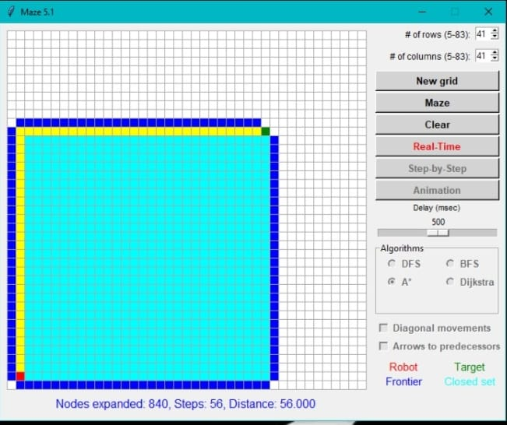
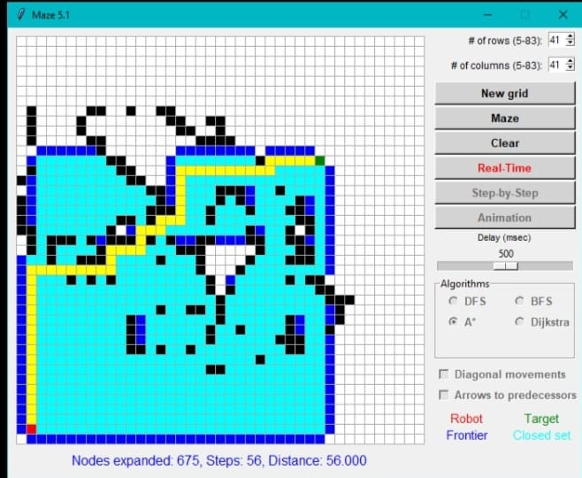
A* with out obstacles
A* with obstacles

Slide 10
Performance Analysis
BFS WITHOUT OBSTACLES
Nodes Expanded -1481
Steps -59
Distance-59.000
BFS WITH OBSTACLES
Nodes expanded -1263
Steps -56
Distance -56.000

Slide 11
DFS WITHOUT OBSTACLES
Nodes Expanded -308
Steps- 308
Distance-308.000
DFS WITH OBSTACLES
Nodes Expanded -1118
Steps - 312
Distance- 312.000

Slide 12
A* WITH OUT OBSTACLES
Nodes Expanded –839
Steps-56
Distance-56.000
A* WITH OBSTACLES
Nodes Expanded – 637
Steps- 56
Distance-56.000

Slide 13
Future scope and Conclusion
Future Scope :
Here the maze path finder algorithms is used to find the path on the labyrinth so we can use that to implement this in the games
Games can be developed in such a way that after reaching the goal the npc character or the pc character can be awarded with a reward
The input images of the maze can be considered by the developer for implementing in their game

Slide 14


